Slide 1
Project – Smartphone Trucker Tracker
Project Presentation Adam Coetzee - 29982995

Slide 2
Background – Trucking Industry
Trucking is essential for the economy
Fleets carry cargo over far distances
Misbehaving truckers are detrimental:
Excessive stopping
Unsafe driving
Managers can’t monitor them
A means of tracking is required

Slide 3
What and how to track?
Acceleration
Rapid acceleration/braking
Altitude
Optimization analysis
Location
Correct locations
Taking optimal routes
Speed
Obeying traffic laws
Driving optimal speeds
Typically included in sensor suites of IoT devices
Accelerometer, gyroscopes, magnetometers GPS units

Slide 4
Problem Statement
Synthesize a tracking system for companies to track Acceleration, Altitude, Location and Speed captured with an IoT device
Continuously (or periodically) upload data to a central storage location
Provide an interface for managers to access this data, in a processed form which can be easily interpreted.

Slide 5
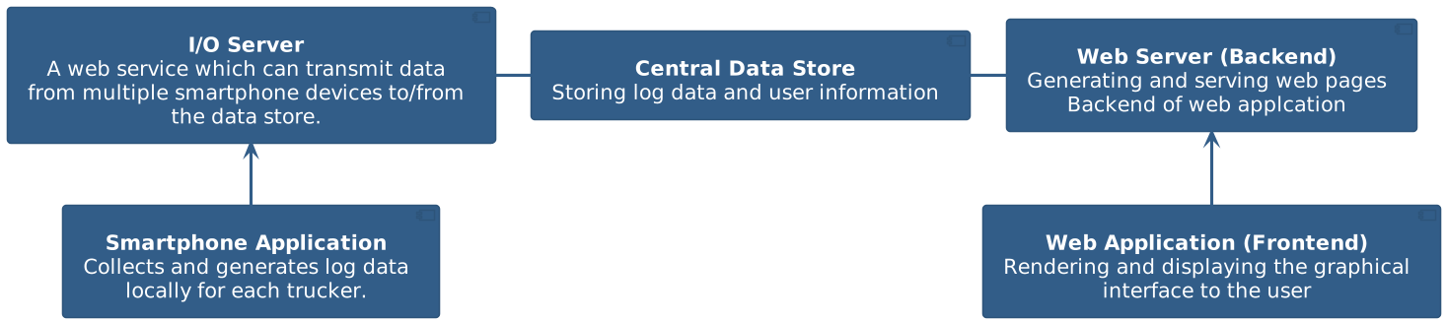
Hypothesis
On-board smartphone sensors
I/O server receives log data from multiple devices
Data stored in Data Store
Web server performs back-end logic serving web pages to web application
Front end of web application renders web pages to manager
Objective:
Use logged data to generate detailed reports conveying useful information to managers
Benefit:
Managers can ensure efficient and proper operation

Slide 6
Requirements
Smartphone Application
Identity Control
Log Acceleration, Altitude, Location and Speed every 2 minutes
Upload log data: Continuously or on request
Store log data locally until it can be transmitted
Log in the background
I/O Server
Connection must be secure
Multiple simultaneously connect
Identity verification and control
Transmit log data into the central database
Data Store
High performance data storage
Web Application
Support multiple managers and truckers
Generate detailed trip information about each trucker:
Start/Stop Locations with corresponding times
Delay between trips
Display acceleration, altitude & location data for analysis

Slide 7

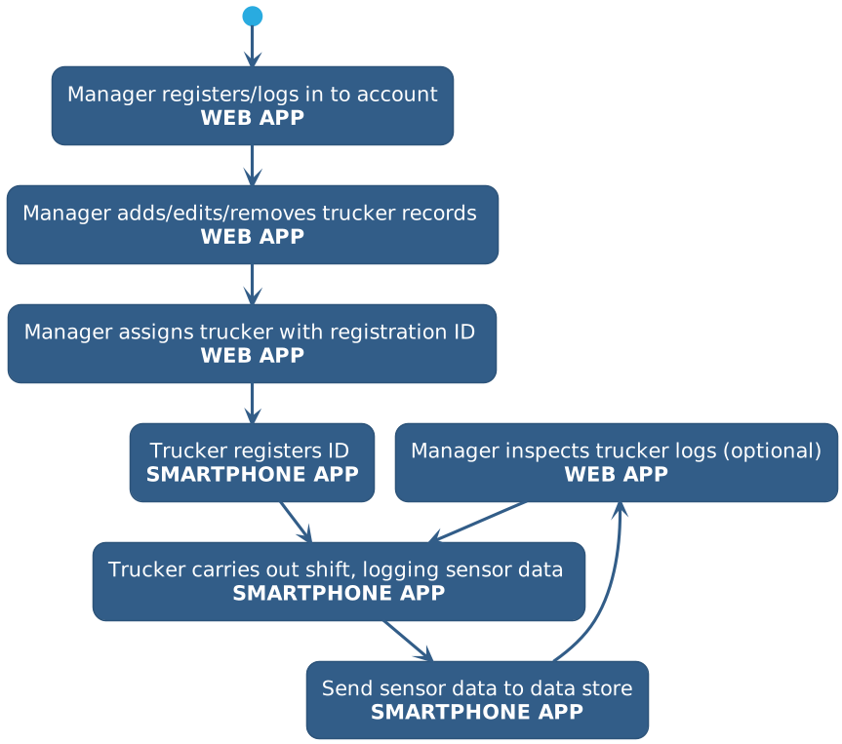
Design – Methodolgy and System Context
C4 model for software design
System context defines high-level simple overview
System lifecycle

Slide 8
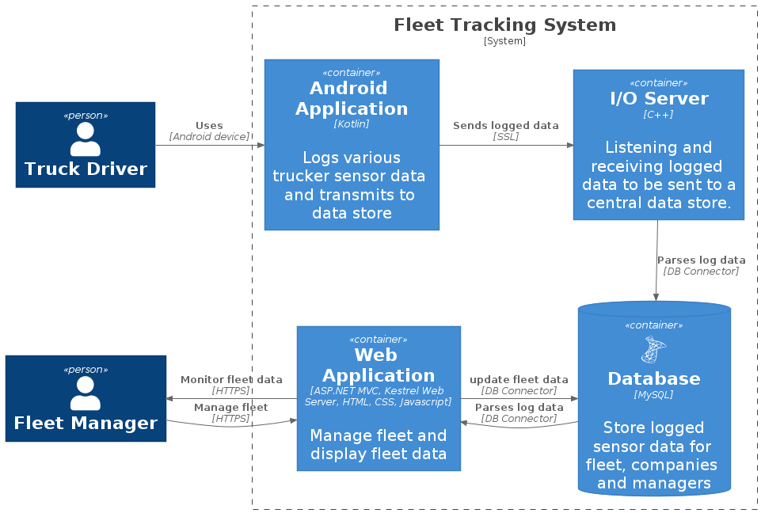
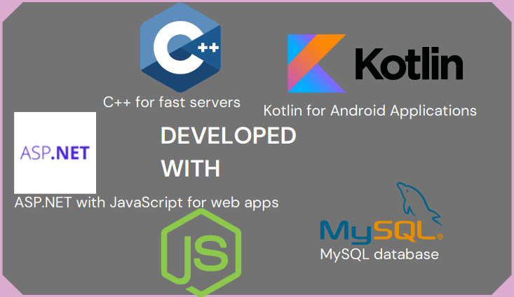
Design - Contained subsystems and technologies
Expanding system context
Android Application
Higher market share
Kotlin provides less verbose code
4.4 covers 99.6% of devices
MySQL
I/O Server
C++ fast and efficient
asio: asynchronous I/O
Web application
ASP.NET
C# backend
HTML/CSS/JS frontend

Slide 9
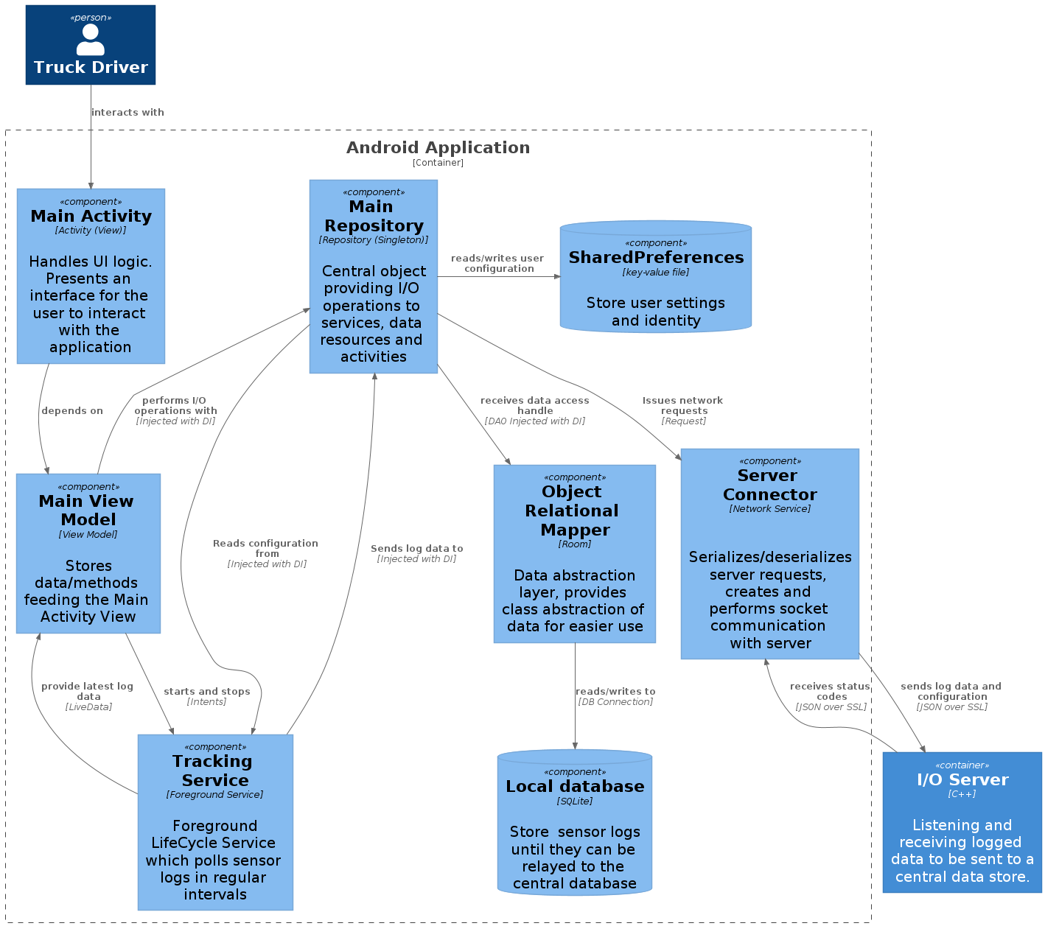
Design – Android Application
Model-View-ViewModel (MVVM)
Main Repository (Singleton): I/O operation calls
Tracking Service (Service Scoped) polls on-board sensors
SharedPreferences: Disk key-value preferences
ORM/Database: SQLite for storing cached log data
Server connector: Implements JSON over SSL protocol for communication

Slide 10
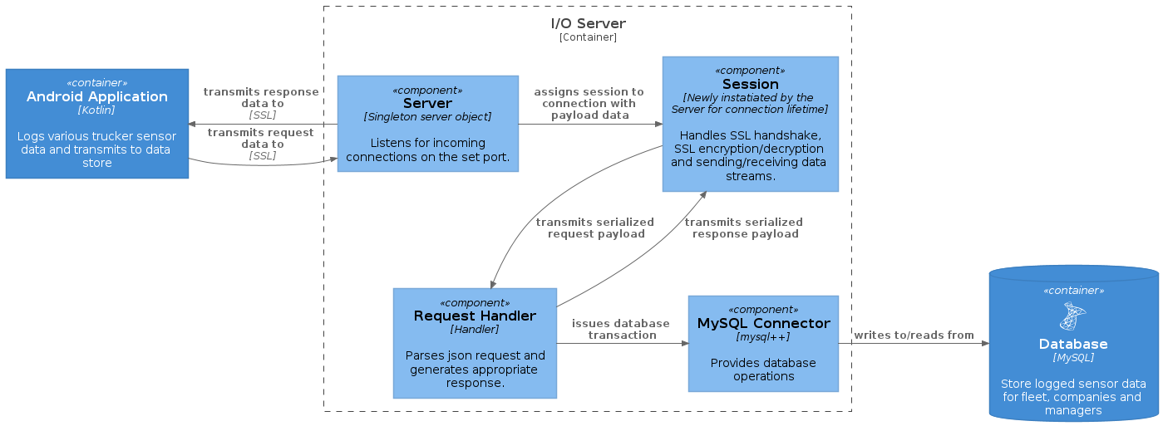
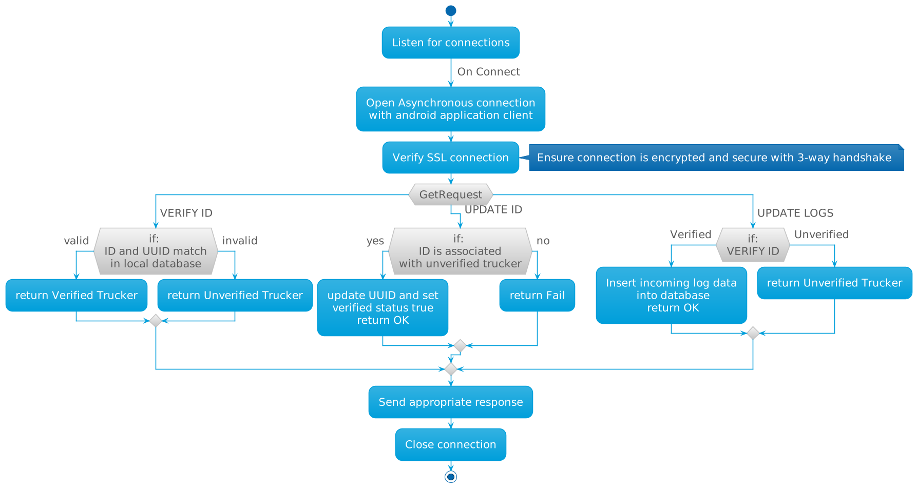
Design – I/O Server
Server class listens for incoming connections
Each connection is assigned a Session which handles SSL implementation, including SSL handshake, sending/receiving messages
Request Handler serializes/deserializes JSON payload and handles business logic for handling request
MySQL Connector handles data access

Slide 11
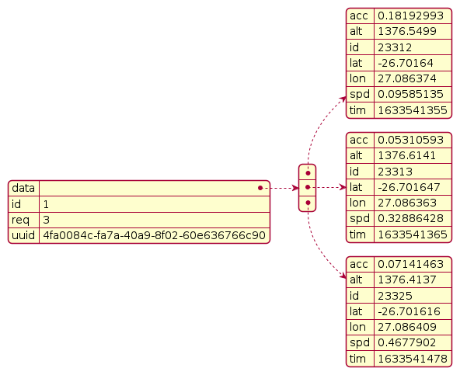
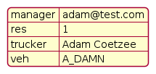
Design – JSON over SSL protocol
Between I/O server and Android Application
Communication is wrapped in a text-based JSON structure
Request payload
Trucker ID
Request Code
Data payload
Response Payload
Response Code
Accompanying data (optional)

Slide 12
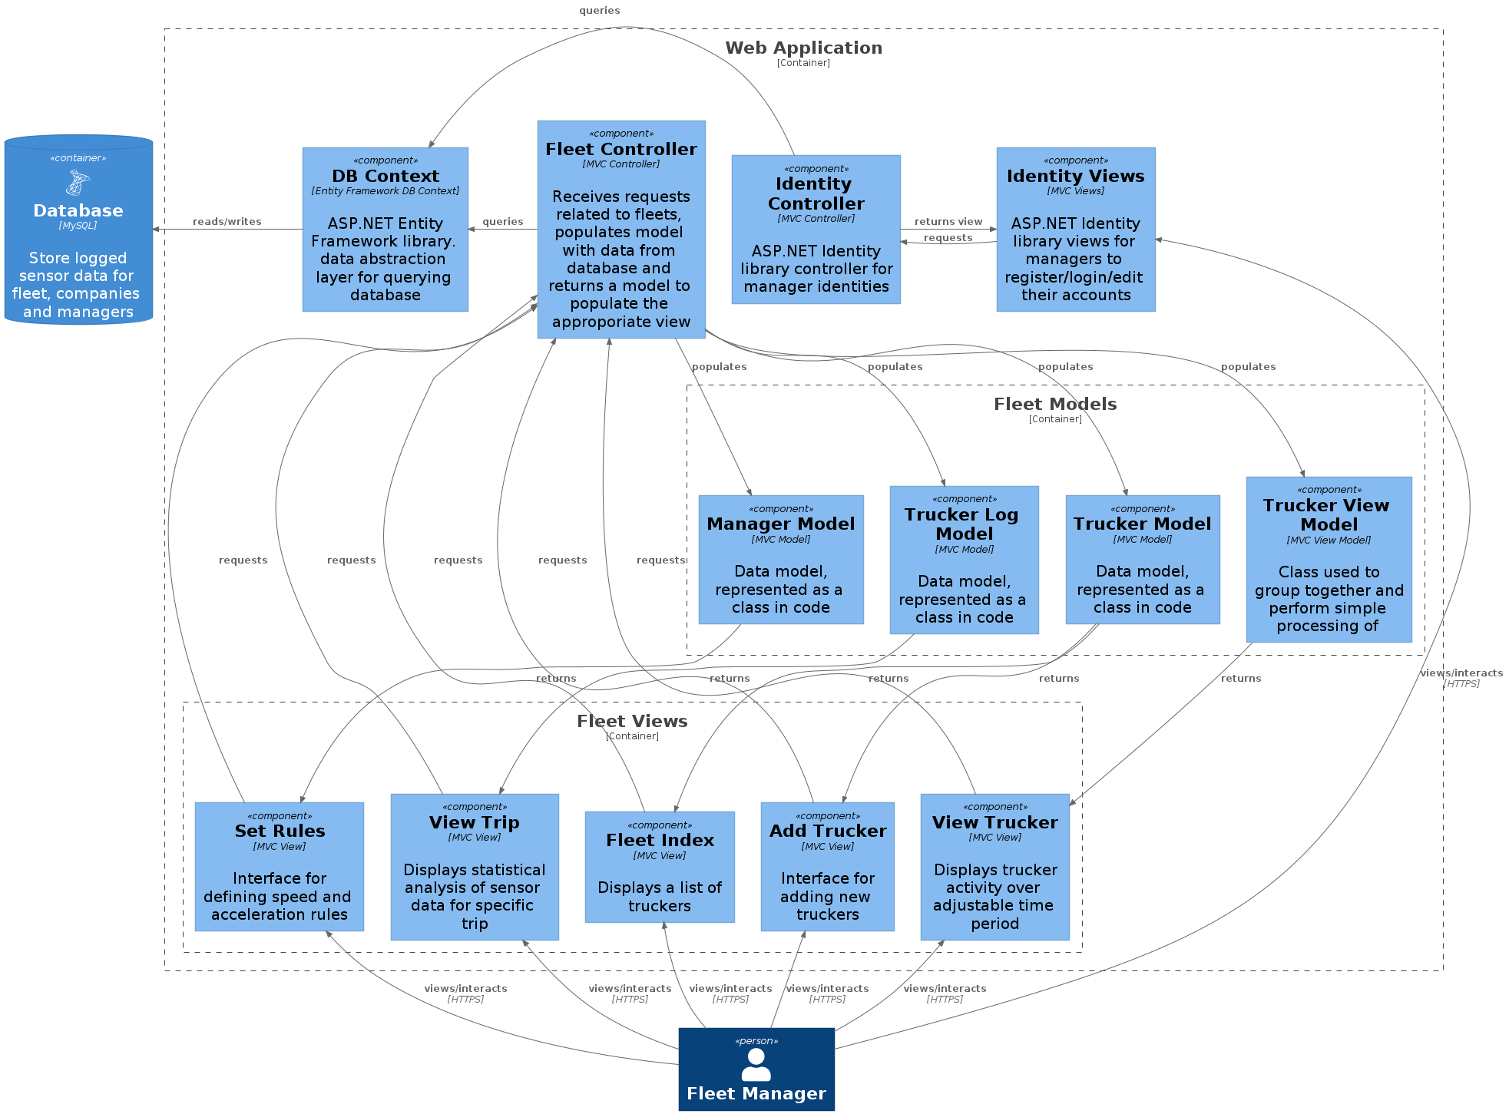
Design – Web Application
MVC architecture
Views for the required displays
Models for conveying data
Controller returns specific models to views upon request
GoogleMaps API for visual map

Slide 13
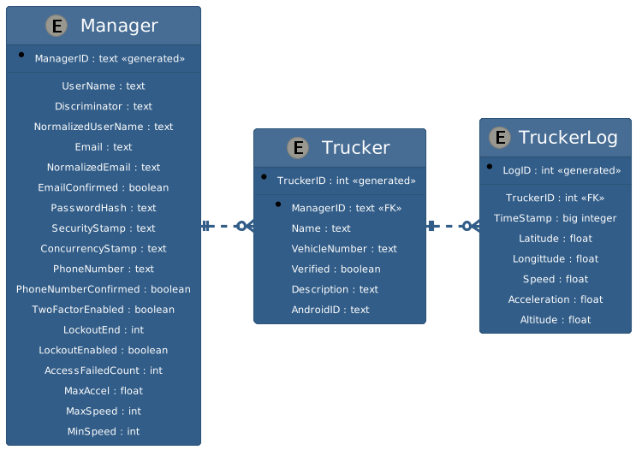
Design – Data Model

Slide 14
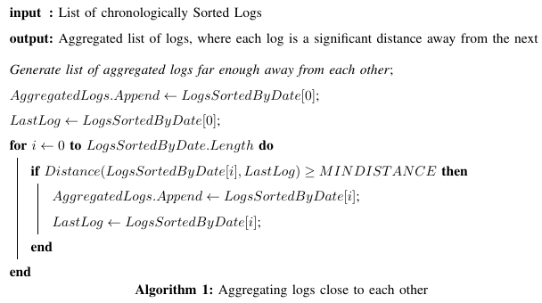
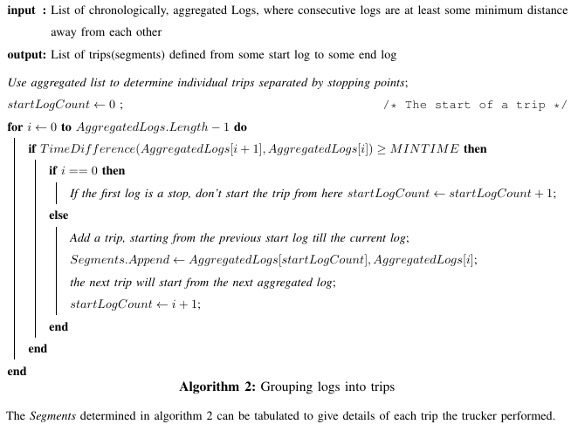
Design – Data Processing
Goal: group GPS data into segments for each trip
Aggregate nearby logs
not helpful to look at location logs very close in distance
use some significant minimum threshold distance
Grouping aggregated logs into seperate trips
Time difference between aggregated logs
if large => trucker probably stopped => trip is complete

Slide 15
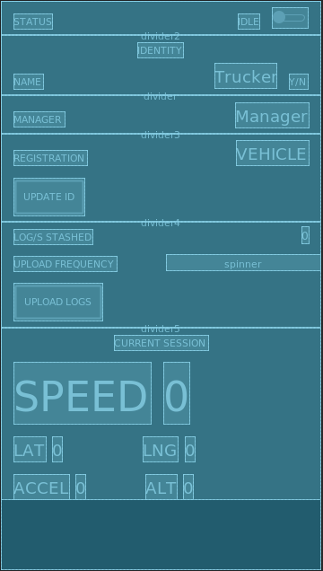
Design – User Interface
Goals:
Dynamic: Adjusting to different screen sizes
Intuitive: Make the layout as obvious as possible
Android Application
XML
Constraint Layout: constraining elements to corners/edges of elements
Web application
HTML div containers
grid layout
CSS with Bootstrap

Slide 16
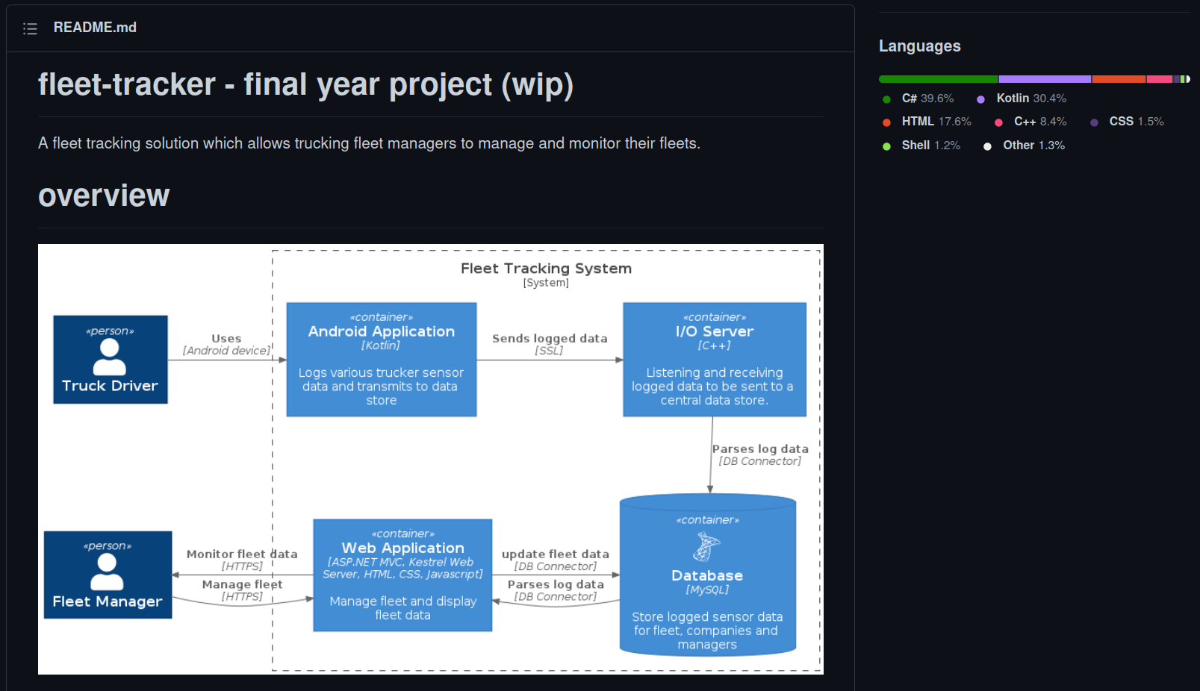
Development and Implementation
Git
Android Studio with Gradle
GCC
Dotnet SDK in Visual Studio Code
Incremental development and testing (git branches)

Slide 17
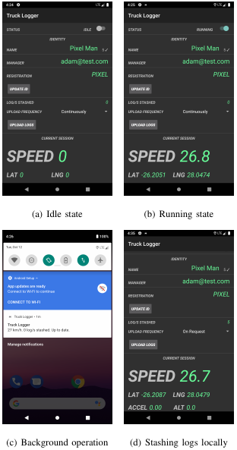
Implementation – Android Application
Idle: Not running
Running: Foreground process polling sensors
Background: Displays notification
Logs are locally stashed
Acceleration is logged only with linear accelerometer (using sensor fusion)

Slide 18
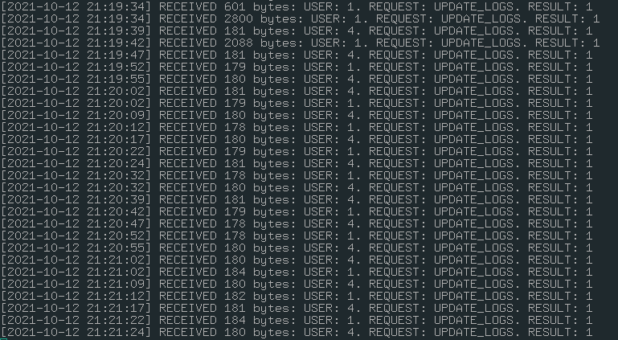
Implementation – I/O Server
Requests
Update ID
Verify ID
Update Logs
Responses
Fail
OK
Invalid Credentials
DB Conn Failed
Parse Fail

Slide 19
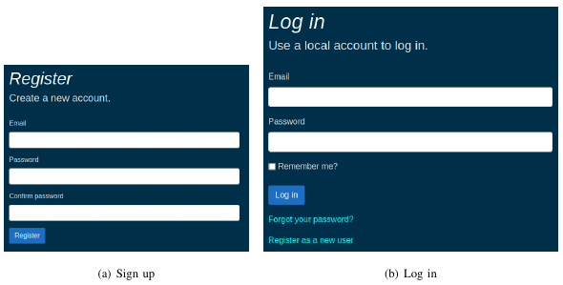
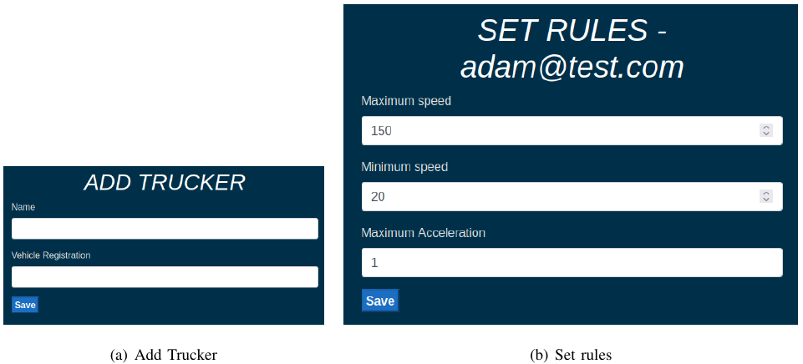
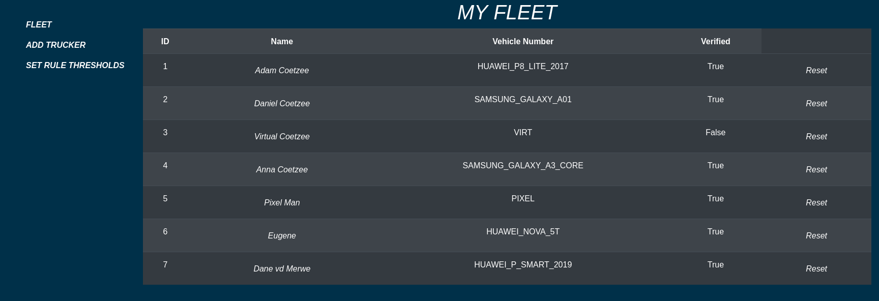
Implementation – Web Application

Slide 20
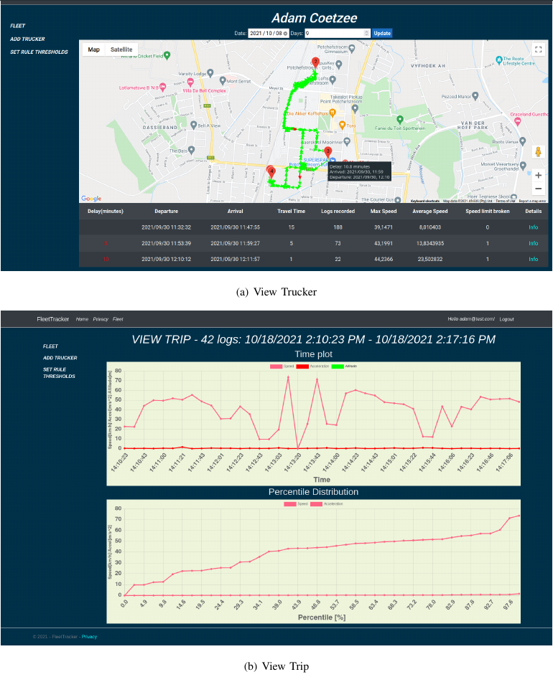
Implementation – Web Application

Slide 21
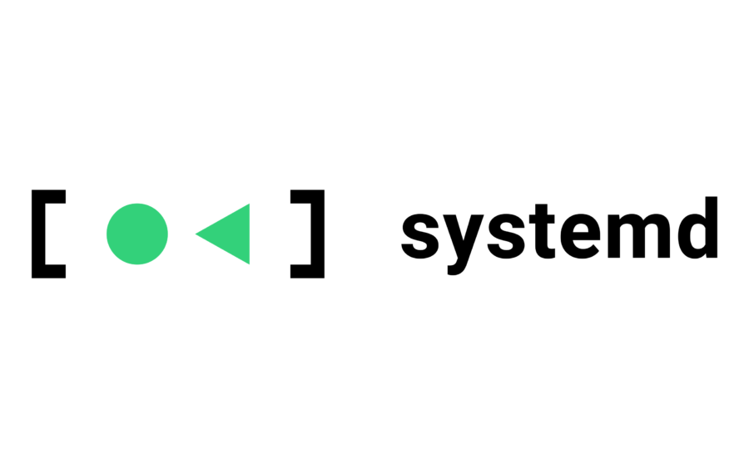

Deployment
Daemons (web app and I/O server) deployed to a Linux VPS on the web
I/O server: Docker containers stable deployment environment
SystemD init system to run web application

Slide 22
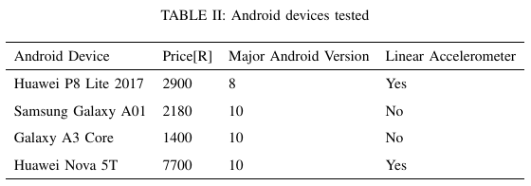
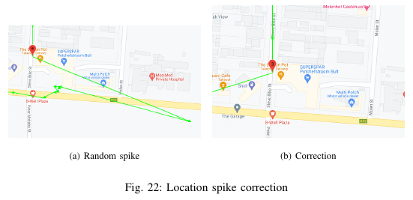
System Evaluation - Testing
4 devices tested
Occasional spikes in location (up to 300m)
Corrected in algorithm 1

Slide 23
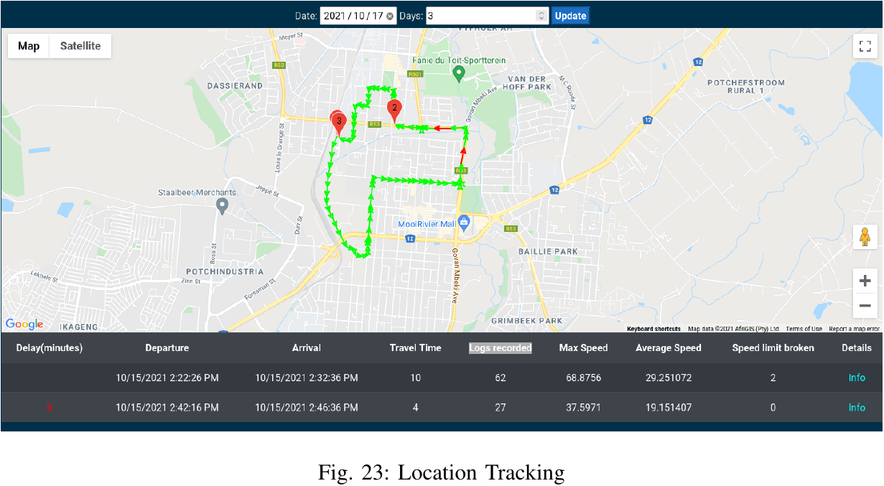
System Evaluation – Location Tracking
Trip to the shop
1st Trip: Fast and erratic
2nd Trip: Slow and steady

Slide 24
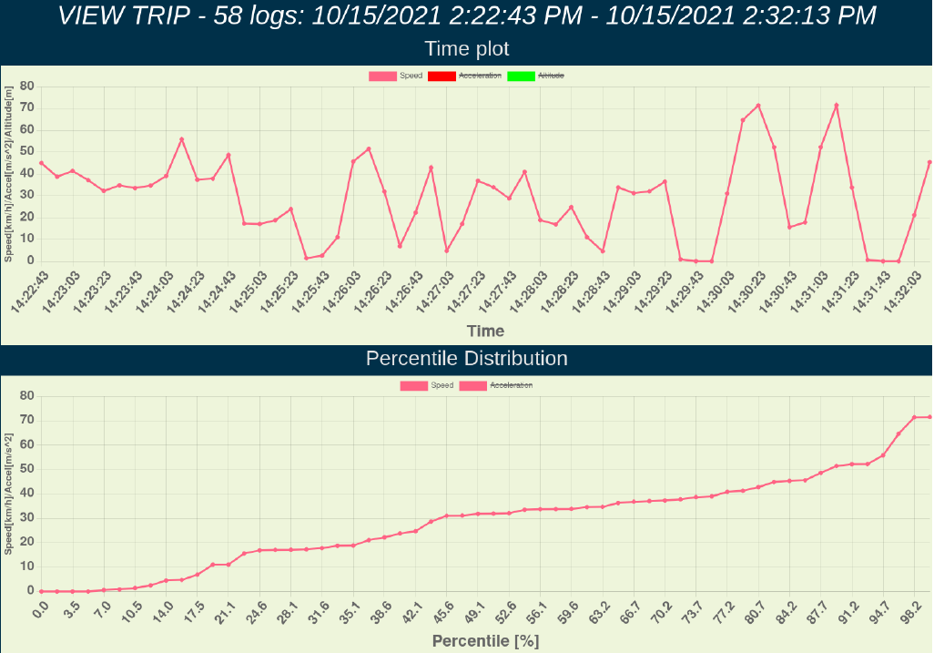
System Evaluation – Speed Tracking

Slide 25
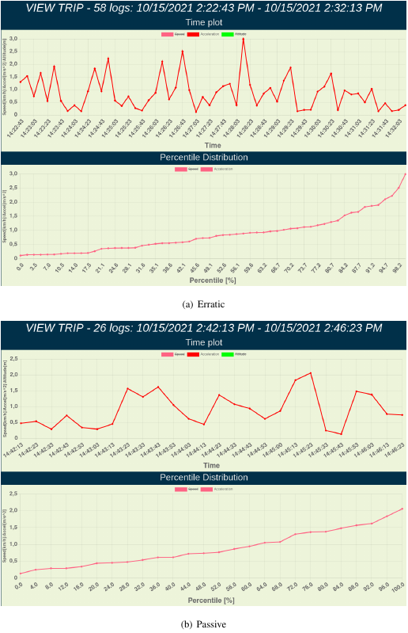
System Evaluation – Acceleration Tracking
Erratic driving:
Steep spikes in acceleration
Higher maxima
Passive driving
smoother spikes
Lower maxima

Slide 26
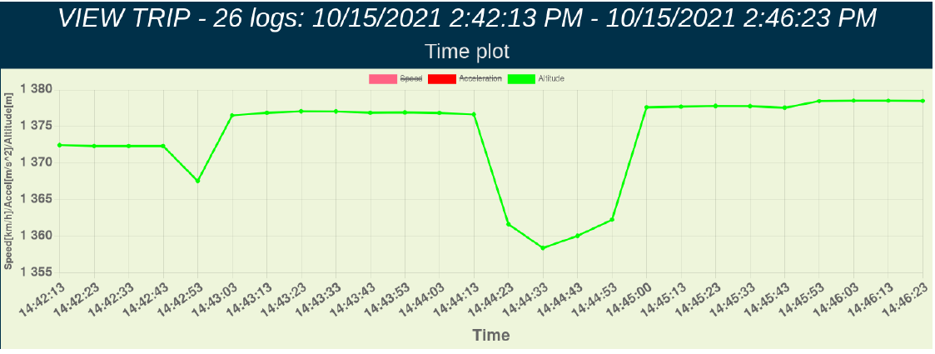
System Evaluation – Altitude Tracking

Slide 27
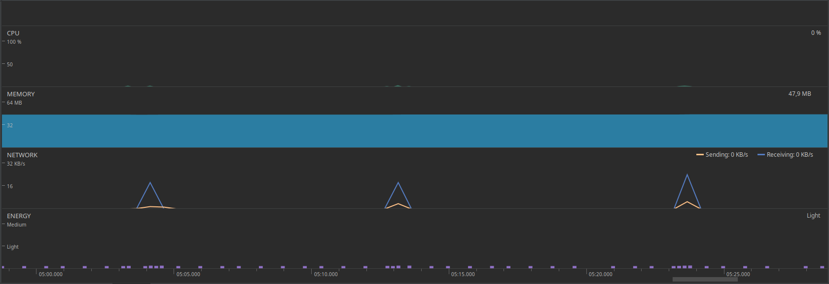
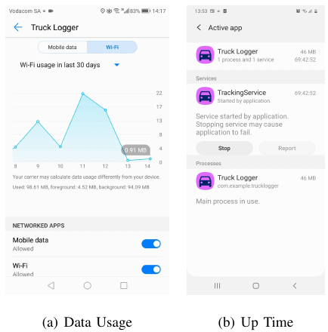
System Evaluation – Android Application
Light on system resources
Data usage must be considered
Good performance on Android 10
Potential issues for other versions

Slide 28
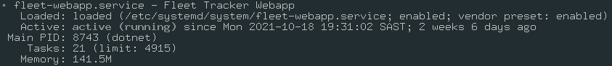
System Evaluation – I/O Server and Web Application
100% uptime: I/O server & Web application
adequate exception handling

Slide 29
Conclusion
Meets objectives and requirements
Android app logs in the background and caches until transmission is possible
I/O server relays data to database
Web Application displays per-trip data
Usability
Android application requires diligent use
Better on new Android versions
Samsung Galaxy A3 reasonable performance at R1400
Multipurpose capabilities
Future Improvements
External sensor integration via CAN bus
Robustness: use of Android init systems etc
Serialization Protocol: minimize data usage
Sensor fusion: Improve sensor readings
Acceleration data should be logged more often

